Slide 1
OSPF Revision

Slide 2
Resources
OSPF Configuration Guide
http://www.cisco.com/c/en/us/td/docs/ios-xml/ios/iproute_ospf/configuration/15-mt/iro-15-mt-book.html
OSPF Design Guide
http://www.cisco.com/c/en/us/support/docs/ip/open-shortest-path-first-ospf/7039-1.html
RFC 2328
https://www.ietf.org/rfc/rfc2328.txt
Routing TCP/IP Vol 1 – Jeff Doyle
http://proquestcombo.safaribooksonline.com/book/networking/tcp-ip/1587052024

Slide 3
OSPF Administrative Distance
Route Source | Administrative Distance
Connected | 0
Static | 1
EIGRP Summary | 5
External BGP | 20
Internal EIGRP | 90
IGRP | 100
OSPF | 110
IS IS | 115
RIP | 120
External EIGRP | 170
Internal BGP | 200

Slide 4
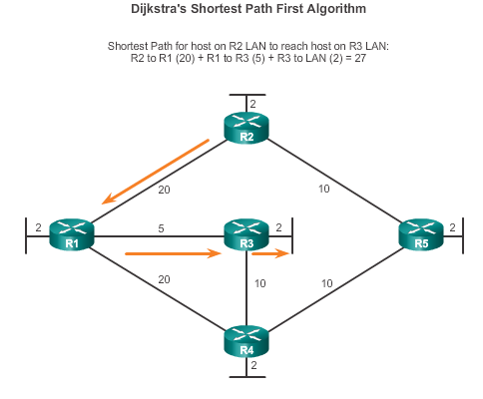
Link-State Routing Protocol Operation Dijkstra’s Algorithm
Notes:
7.4.1.2 Dijkstra's Algorithm
Cumulative Cost metric

Slide 5
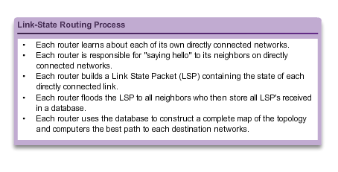
Link-State Updates Link-State Routing Process
Notes:
7.4.2.1 Link-State Routing Process

Slide 6
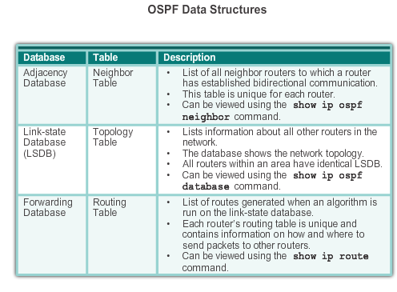
Open Shortest Path First Components of OSPF
Notes:
8.1.1.3 Components of OSPF

Slide 7
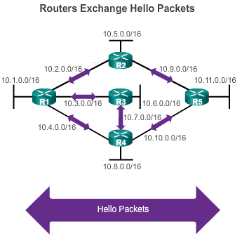
Open Shortest Path First Link-State Operation
If a neighbor is present, the OSPF-enabled router attempts to establish a neighbor adjacency with that neighbor
Notes:
8.1.1.4 Link-State Operation

Slide 8
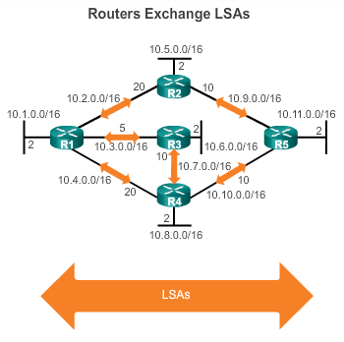
Open Shortest Path First Link-State Operation (cont.)
LSAs contain the state and cost of each directly connected link.
Routers flood their LSAs to adjacent neighbors.
Adjacent neighbors receiving the LSA immediately flood the LSA to other directly connected neighbors, until all routers in the area have all LSAs.
Notes:
8.1.1.4 Link-State Operation (cont.)

Slide 9
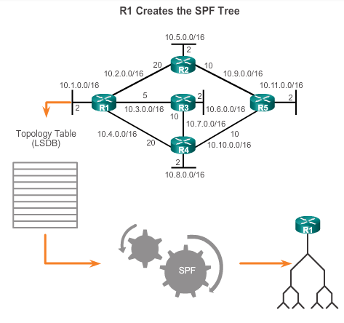
Open Shortest Path First Link-State Operation
Build the topology table based on the received LSAs.
This database eventually holds all the information about the topology of the network.
Execute the SPF Algorithm.
Notes:
8.1.1.4 Link-State Operation (cont.)

Slide 10
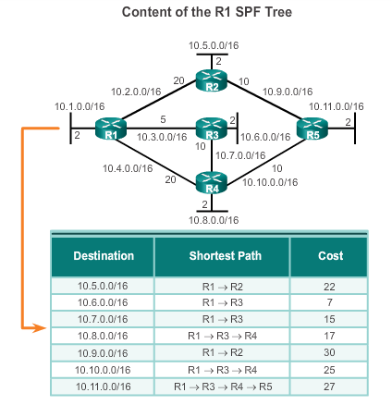
Open Shortest Path First Link-State Operation (cont.)
From the SPF tree, the best paths are inserted into the routing table.
Notes:
8.1.1.4 Link-State Operation (cont.)

Slide 11
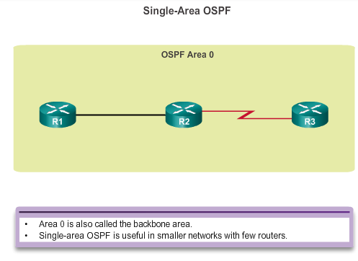
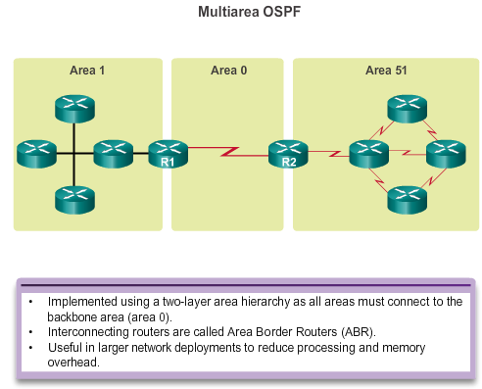
Open Shortest Path First Single-area and Multiarea OSPF
Notes:
8.1.1.5 Single-Area and Multiarea OSPF

Slide 12
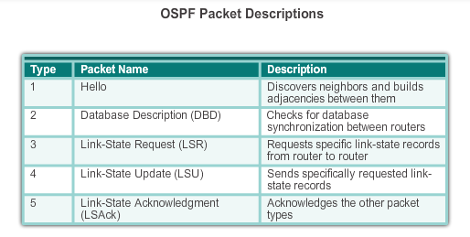
OSPF Messages Types of OSPF Packets
Notes:
8.1.2.2 Types of OSPF Packets
DBD = summary of LSDB

Slide 13
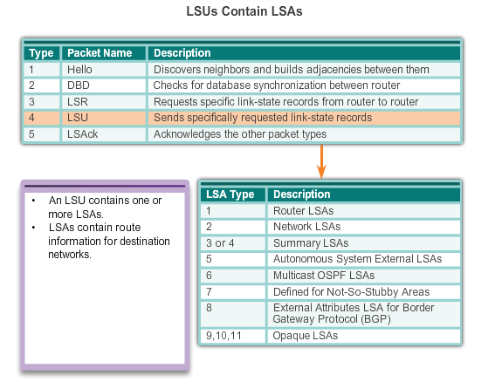
OSPF Messages Link-State Updates
Notes:
8.1.2.5 Link-State Updates

Slide 14
OSPF Messages Hello Packet Intervals
OSPF Hello packets are transmitted:
To 224.0.0.5 in IPv4 and FF02::5 in IPv6 (all OSPF routers)
Every 10 seconds (default on multiaccess and point-to-point networks)
Every 30 seconds (default on non-broadcast multiaccess [NBMA] networks)
Dead interval is the period that the router waits to receive a Hello packet before declaring the neighbor down
Router floods the LSDB with information about down neighbors out all OSPF enabled interfaces
Cisco’s default dead interval is 4 times the Hello interval
Notes:
8.1.2.4 Hello Packet Intervals (cont.)
Timers must match or neighbor will not form.
NBMA = legacy networks = ATM, Frame relay, x.25

Slide 15
Type 1 - OSPF Hello Packet
Hello packet fields must match on neighboring routers for them to establish an adjacency:
Hello interval
Dead interval
Network type.
Area id
Authentication password
Stub area flag
Two routers on the same network segment may not form an OSPF adjacency if:
They are not in the same area
The subnet masks do not match, causing the routers to be on separate networks.
The OSPF Hello or Dead Timers do not match.
The OSPF network types do not match.
The OSPF network command is missing or incorrect.

Slide 16
OSPF States
Neighbor Discovery – Hello Protocol
Down State
No Hello packets received = Down
Send Hello Packets
Transit to Init state
When an OSPF router is initially connected to a network it attempts to create adjacencies with neighbors.
To do so, it progresses through these various states using the 5 OSPF packet types.
Init State
Hello packets received from the neighbor and it contains the initial router’s router ID.
Transit to two-way state
Two-Way State
(Optional) DR and BDR election
Transit to ExStart state
Database Synchronization
ExStart State
Negotiate master / slave relationship and DBD packet sequence number
More LSAs required
No
Yes
DBD exchanged as LSAs are requested and sent
Transit to either Loading or Full state after completing the database description
Exchange State
Loading State
Newly learned routes are asked for and current database is being processed
Route Calculations
Full State
Router is synchronized with the neighbor and route calculations using the SPF algorithm begins
Notes:
When a router is added to a link state topology it first learns about its directly connected networks when its interfaces reach the up state.
It then builds a Link State Packet (LSP) containing the state and cost of each directly connected link.
LSPs are then flooded to all neighbors upon initial startup. LSPs are also sent whenever a network topology change occurs.
Neighbors immediately flood the LSPs out to other OSPF neighbors.
Neighbors also use the LSPs to construct a complete map of the topology and compute the best path to each destination network.
The final step is that SPF (Dijkstra algorithm) computes the best path to each destination network and populates the routing table.
After the initial LSP flooding, OSPF routers require less bandwidth to communicate changes in a topology. Instead they send LSPs (triggered updates) when the network change to speed up convergence.

Slide 17
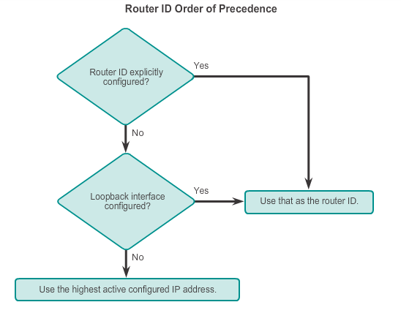
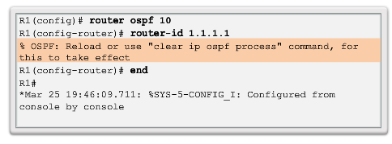
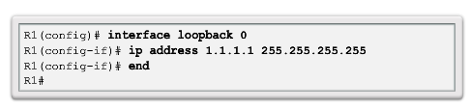
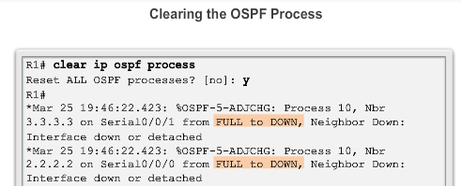
OSPF Router ID Router IDs
Notes:
This is a 32-bit number that uniquely identifies the router in the Autonomous System. If a router's OSPF Router ID is changed, the router's OSPF software should be restarted before the new Router ID takes effect.

Slide 18
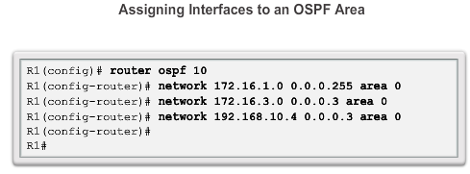
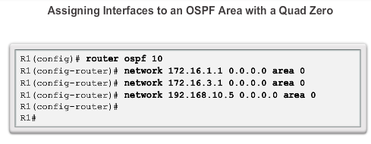
Configure Single-area OSPFv2 The network Command
Notes:
Turns OSPF process on for matching interface
Advertises associated network for that interface
Inverse / wildcard mask – quick calculation = subtract actual mask from 255.255.255.255
Or know that it is 1 less than the network size (increment)
255.255.255.255 – 255.255.255.240 = 0.0.0.15
.240 = increment of 16 – 1 = 15
0.0.0.0 255.255.255.255 = all interfaces

Slide 19
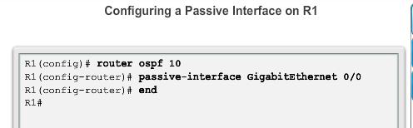
Configure Single-area OSPFv2 Configuring Passive Interfaces
Use the passive-interface router configuration mode command to prevent the transmission of routing messages through a router interface, but still allow that network to be advertised to other routers.
Notes:
8.2.2.5 Configuring Passive Interfaces

Slide 20
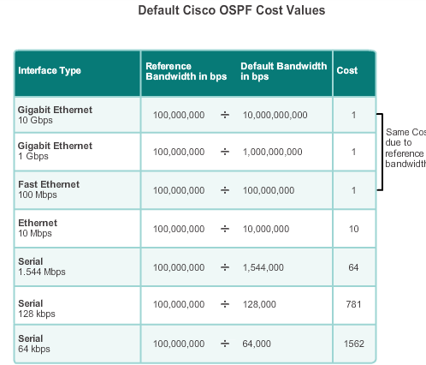
OSPF Cost OSPF Metric = Cost
Cost = reference bandwidth / interface bandwidth
(default reference bandwidth is 10^8)
Cost = 100,000,000 bps / interface bandwidth in bps
Notes:
8.2.3.1 OSPF Metric = Cost
Cost = 100Mb / interface BW

Slide 21
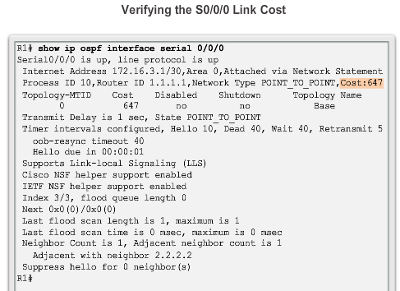
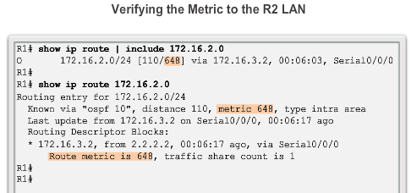
OSPF Cost Adjusting the Reference Bandwidth
Use the command - auto-cost reference-bandwidth
Must be configured on every router in the OSPF domain
Notice that the value is expressed in Mb/s:
Gigabit Ethernet - auto-cost reference-bandwidth 1000
10 Gigabit Ethernet - auto-cost reference-bandwidth 10000
Notes:
8.2.3.3 Adjusting the Reference Bandwidth

Slide 22
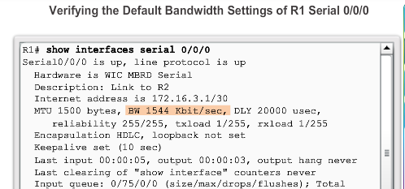
OSPF Cost Default Interface Bandwidths
On Cisco routers, the default bandwidth on most serial interfaces is set to 1.544 Mb/s.
Notes:
8.2.3.4 Default Interface Bandwidths

Slide 23
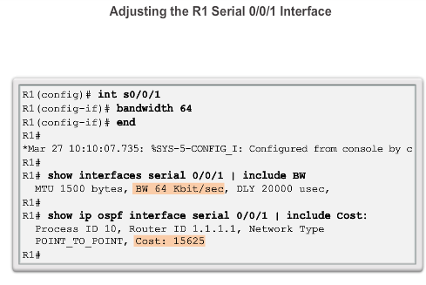
OSPF Cost Adjusting the Interface Bandwidths
Notes:
8.2.3.5 Adjusting the Interface Bandwidths

Slide 24
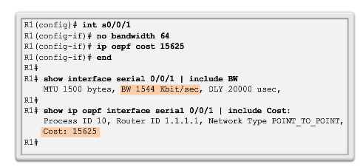
OSPF Cost Manually Setting the OSPF Cost
Both the bandwidth interface command and the ip ospf cost interface command achieve the same result, which is to provide an accurate value for use by OSPF in determining the best route.
ip ospf cost overrides dynamic cost calculation
Notes:
8.2.3.6 Manually Setting the OSPF Cost

Slide 25
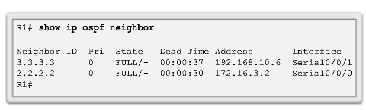
Verify OSPF Verify OSPF Neighbors
Verify that the router has formed an adjacency with its neighboring routers.
Notes:
8.2.4.1 Verify OSPF Neighbors

Slide 26
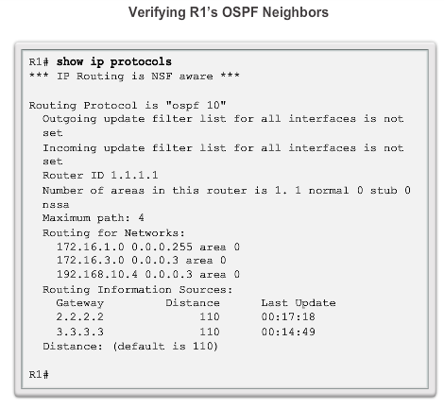
Verify OSPF Verify OSPF Protocol Settings
Notes:
8.2.4.2 Verify OSPF Protocol Settings

Slide 27
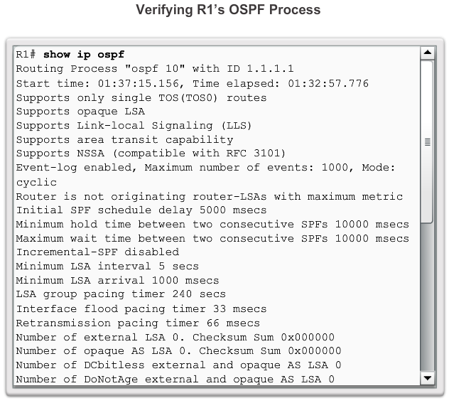
Verify OSPF Verify OSPF Process Information
Notes:
8.2.4.3 Verify OSPF Process Information

Slide 28
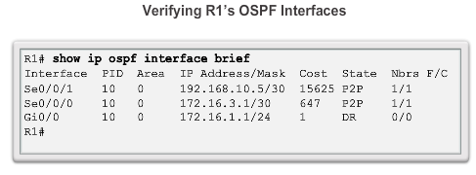
Verify OSPF Verify OSPF Interface Settings
Notes:
8.2.4.4 Verify OSPF Interface Settings

Slide 29
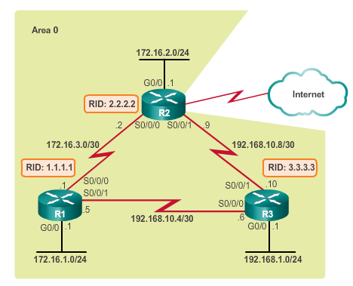
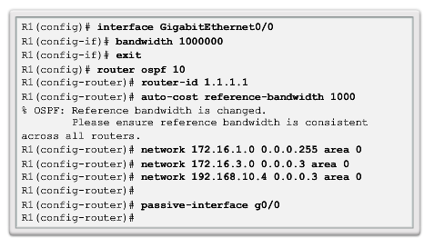
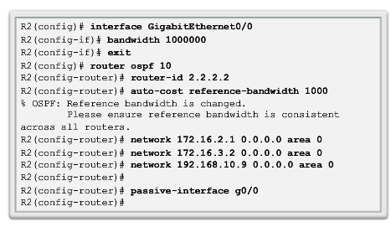
Routing in the Distribution and Core Layers Configuring Single-Area OSPF
Notes:
5.1.1.5 Configuring Single-Area OSPF

Slide 30
OSPF in Multiaccess Networks OSPF Network Types
Point-to-point – Two routers interconnected over a common link. Often the configuration in WAN links.
Broadcast Multiaccess – Multiple routers interconnected over an Ethernet network.
Non-broadcast Multiaccess (NBMA) – Multiple routers interconnected in a network that does not allow broadcasts, such as Frame Relay.
Point-to-multipoint – Multiple routers interconnected in a hub-and-spoke topology over an NBMA network.
Virtual links – Special OSPF network used to interconnect distant OSPF areas to the backbone area.
Notes:
5.1.2.1 OSPF Network Types
Primary Focus is on Point-to-point & Broadcast

Slide 31
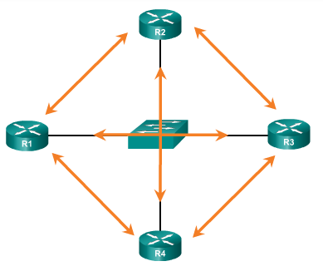
OSPF in Multiaccess Networks Challenges in Multiaccess Networks
Multiaccess networks can create two challenges for OSPF:
Creation of multiple adjacencies – creating adjacencies with multiple routers would lead to an excessive number of LSAs being exchanged.
Extensive flooding of LSAs – Link-state routers flood the network when OSPF is initialized or when there is a change.
Formula used to calculate the number of required adjacencies n(n-1)/2
A topology of 4 routers would result in 4(4-1)/2 = 6
Notes:
5.1.2.2 Challenges in Multiaccess Networks

Slide 32
OSPF in Multiaccess Networks OSPF Designated Router
The designated router (DR) is the solution to managing adjacencies and flooding of LSAs on a multiaccess network.
The backup designated router (BDR) is elected in case the DR fails.
All other non-DR and non-BDR routers become DROTHERs. DROTHERs only form adjacencies with the DR and BDR.
DROTHERs only send their LSAs to the DR and BDR using the multicast address 224.0.0.6.
DR uses the multicast address 224.0.0.5 to send LSAs to all other routers. DR only router flooding LSAs.
DR/BDR Elections only necessary on multiaccess networks.
Notes:
5.1.2.3 OSPF Designated Router

Slide 33
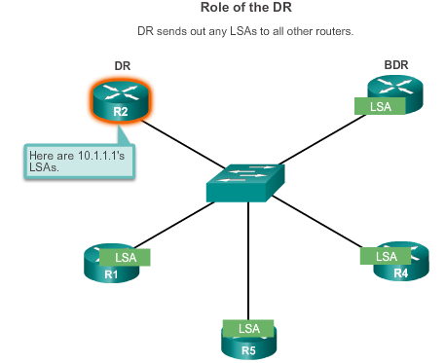
OSPF in Multiaccess Networks OSPF Designated Router (cont.)
Notes:
5.1.2.3 OSPF Designated Router

Slide 34
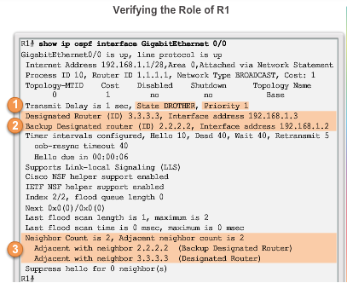
OSPF in Multiaccess Networks Verifying DR/BDR Roles
Notes:
5.1.2.4 Verifying DR/BDR Roles

Slide 35
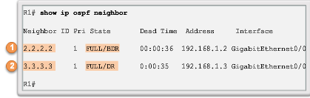
OSPF in Multiaccess Networks Verifying DR/BDR Adjacencies
State of neighbors in multiaccess networks can be:
FULL/DROTHER – This is a DR or BDR router that is fully adjacent with a non-DR or BDR router.
FULL/DR – The router is fully adjacent with the indicated DR neighbor.
FULL/BDR – The router is fully adjacent with the indicated BDR neighbor.
2-WAY/DROTHER – The non-DR or BDR router has a neighbor adjacency with another non-DR or BDR router.
Notes:
5.1.2.5 Verifying DR/BDR Adjacencies

Slide 36
OSPF in Multiaccess Networks Default DR/BDR Election Process
The router with the highest interface priority is elected as the DR.
The router with the second highest interface priority is elected as the BDR.
Priority can be configured between 0-255. (Priority of 0 - router cannot become the DR. 0
If interface priorities are equal, then the router with highest router ID is elected DR and second highest the BDR
Three ways to determine router ID:
Router ID can be manually configured.
If not configured, the ID determined by the highest loopback IP address.
If no loopbacks, the ID is determined by the highest active IPv4 address.
In an IPv6 network, the router ID must be configured manually.
Notes:
5.1.2.6 Default DR/BDR Election Process
Default priority = 1

Slide 37
OSPF in Multiaccess Networks DR/BDR Election Process
DR remains the DR until one of the following occurs:
The DR fails.
The OSPF process on the DR fails or is stopped.
The multiaccess interface on the DR fails or is shutdown.
If the DR fails, the BDR is automatically promoted to DR.
There is then a new BDR election and the DROTHER with the higher priority or router ID is elected as the new BDR.
Notes:
5.1.2.7 DR/BDR Election Process

Slide 38
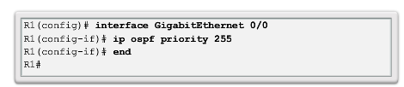
OSPF in Multiaccess Networks The OSPF Priority
Instead of setting the router ID on all routers, it is better to control the election by setting interface priorities.
To change the priority, use one of the following commands:
ip ospf priority value (OSPFv2 interface command)
ipv6 ospf priority value (OSPFv3 interface command)
To begin another OSPF election, use one of the following methods:
Shutdown the router interfaces and then re-enable them starting with the DR, then the BDR, and then all other routers.
Reset the OSPF process using the clear ip ospf process privileged EXEC mode command on all routers.
Notes:
5.1.2.8 The OSPF Priority
5.1.2.9 Changing the OSPF priority

Slide 39
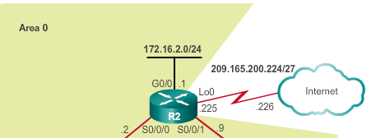
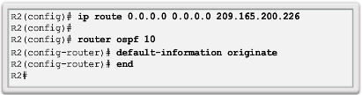
Default Route Propagation Propagating a Default Static Route in OSPFv2
The router connected to the Internet that is used to propagate a default route is often called the edge, entrance or gateway router. In an OSPF network, it may also be call the autonomous system boundary router (ASBR).
Notes:
5.1.3.1 Propagating a Default Static Route in OSPFv2
The default route must exist before it can be propagated.
Alternatively
default-information originate always does not require a default route to exist

Slide 40
Secure OSPF Configuring OSPF MD5 Authentication
MD5 authentication can be enabled globally for all interfaces or on a per-interface basis.
To enable OSPF MD5 authentication globally, configure:
ip ospf message-digest-key key md5 password (interface configuration command)
area area-id authentication message-digest (router configuration command)
To enable MD5 authentication on a per-interface basis, configure:
ip ospf message-digest-key key md5 password (interface configuration command)
ip ospf authentication message-digest (interface configuration command)
Notes:
5.1.5.4 Configuring OSPF MD5 Authentication
Authenticates peers
All neighboring routers on the same network must have the same key-id and the same key value.

Slide 41
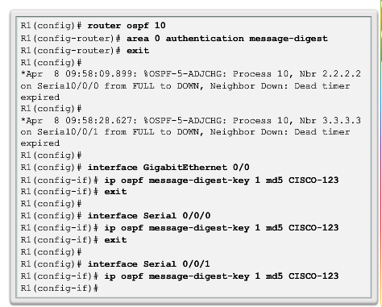
Secure OSPF OSPF MD5 Authentication Example - Global
continued
Notes:
5.1.5.5 OSPF MD5 Authentication Example

Slide 42
Configuring MD5 Authentication Per Interface
R1# show running-config
!
<output omitted>
!
interface Fa0/0
ip address 10.1.1.1 255.255.255.0
!
<output omitted>
!
interface Serial0/0/1
ip address 192.168.1.101 255.255.255.224
ip ospf authentication message-digest
ip ospf message-digest-key 1 md5 SECRETPASS
!
<output omitted>
!
router ospf 10
log-adjacency-changes
network 10.1.1.1 0.0.0.0 area 0
network 192.168.1.0 0.0.0.255 area 0
!
<output omitted>
Area 0
192.168.1.96 /27
.101
R1
S0/0/1
.102
R2
.1
S0/0/1
Fa0/0
.1
Fa0/0
10.1.1.0 /24
10.2.2.0 /24

Slide 43
Components of Troubleshooting Single-Area OSPF OSPF Troubleshooting Commands
show ip protocols – Verifies vital OSPF configuration information.
show ip ospf neighbor – Verifies that the router has formed an adjacency with its neighboring routers.
show ip ospf interface – Displays the OSPF parameters configured on an interface, such as the OSPF process ID.
show ip ospf – Examines the OSPF process ID and router ID.
show ip route ospf – Displays only the OSPF learned routes in the routing table.
clear ip ospf [process-id] process – Resets the OSPFv2 neighbor adjacencies.
Notes:
5.2.1.3 OSPF Troubleshooting Commands

